Slide 1
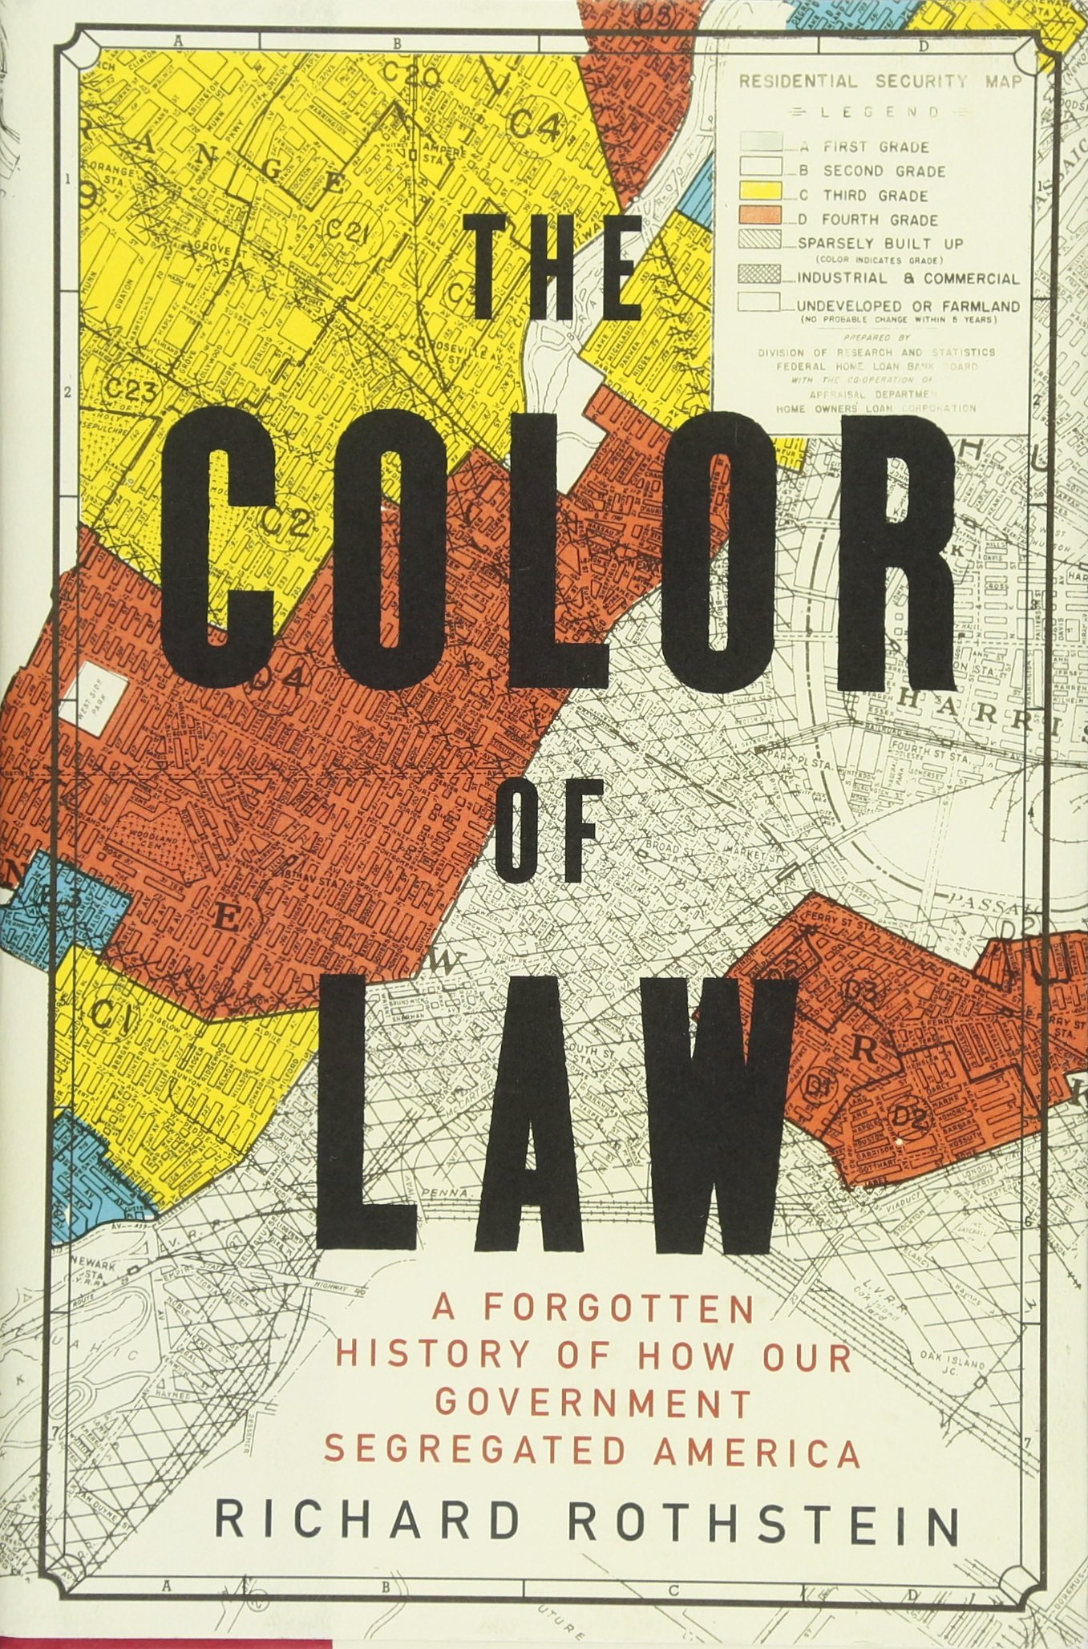
Color of Law Project
Presented by the VT Student Anti-Racism Network
A presentation for teachers

Slide 2
We are the VT Student Anti-Racism Network
We are group of students from around the State working for anti-racism in our schools.
Students across VT want to learn more about racism and discrimination, as shown through a survey we took of high schoolers in Vermont documenting their experience with racism and diversity education in school...

Slide 3
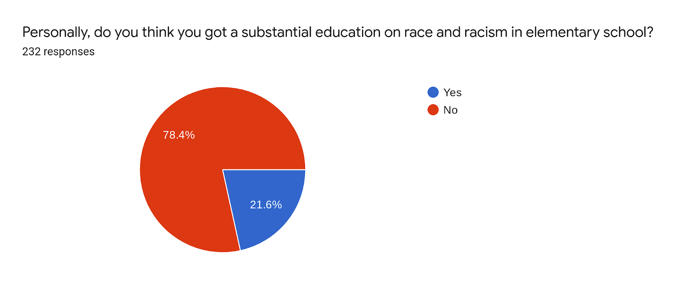
Other compelling results from our statewide student survey are linked here!
Survey Results
Less than 25% of VT Youth say they are receiving a substantial education on racism

Slide 4
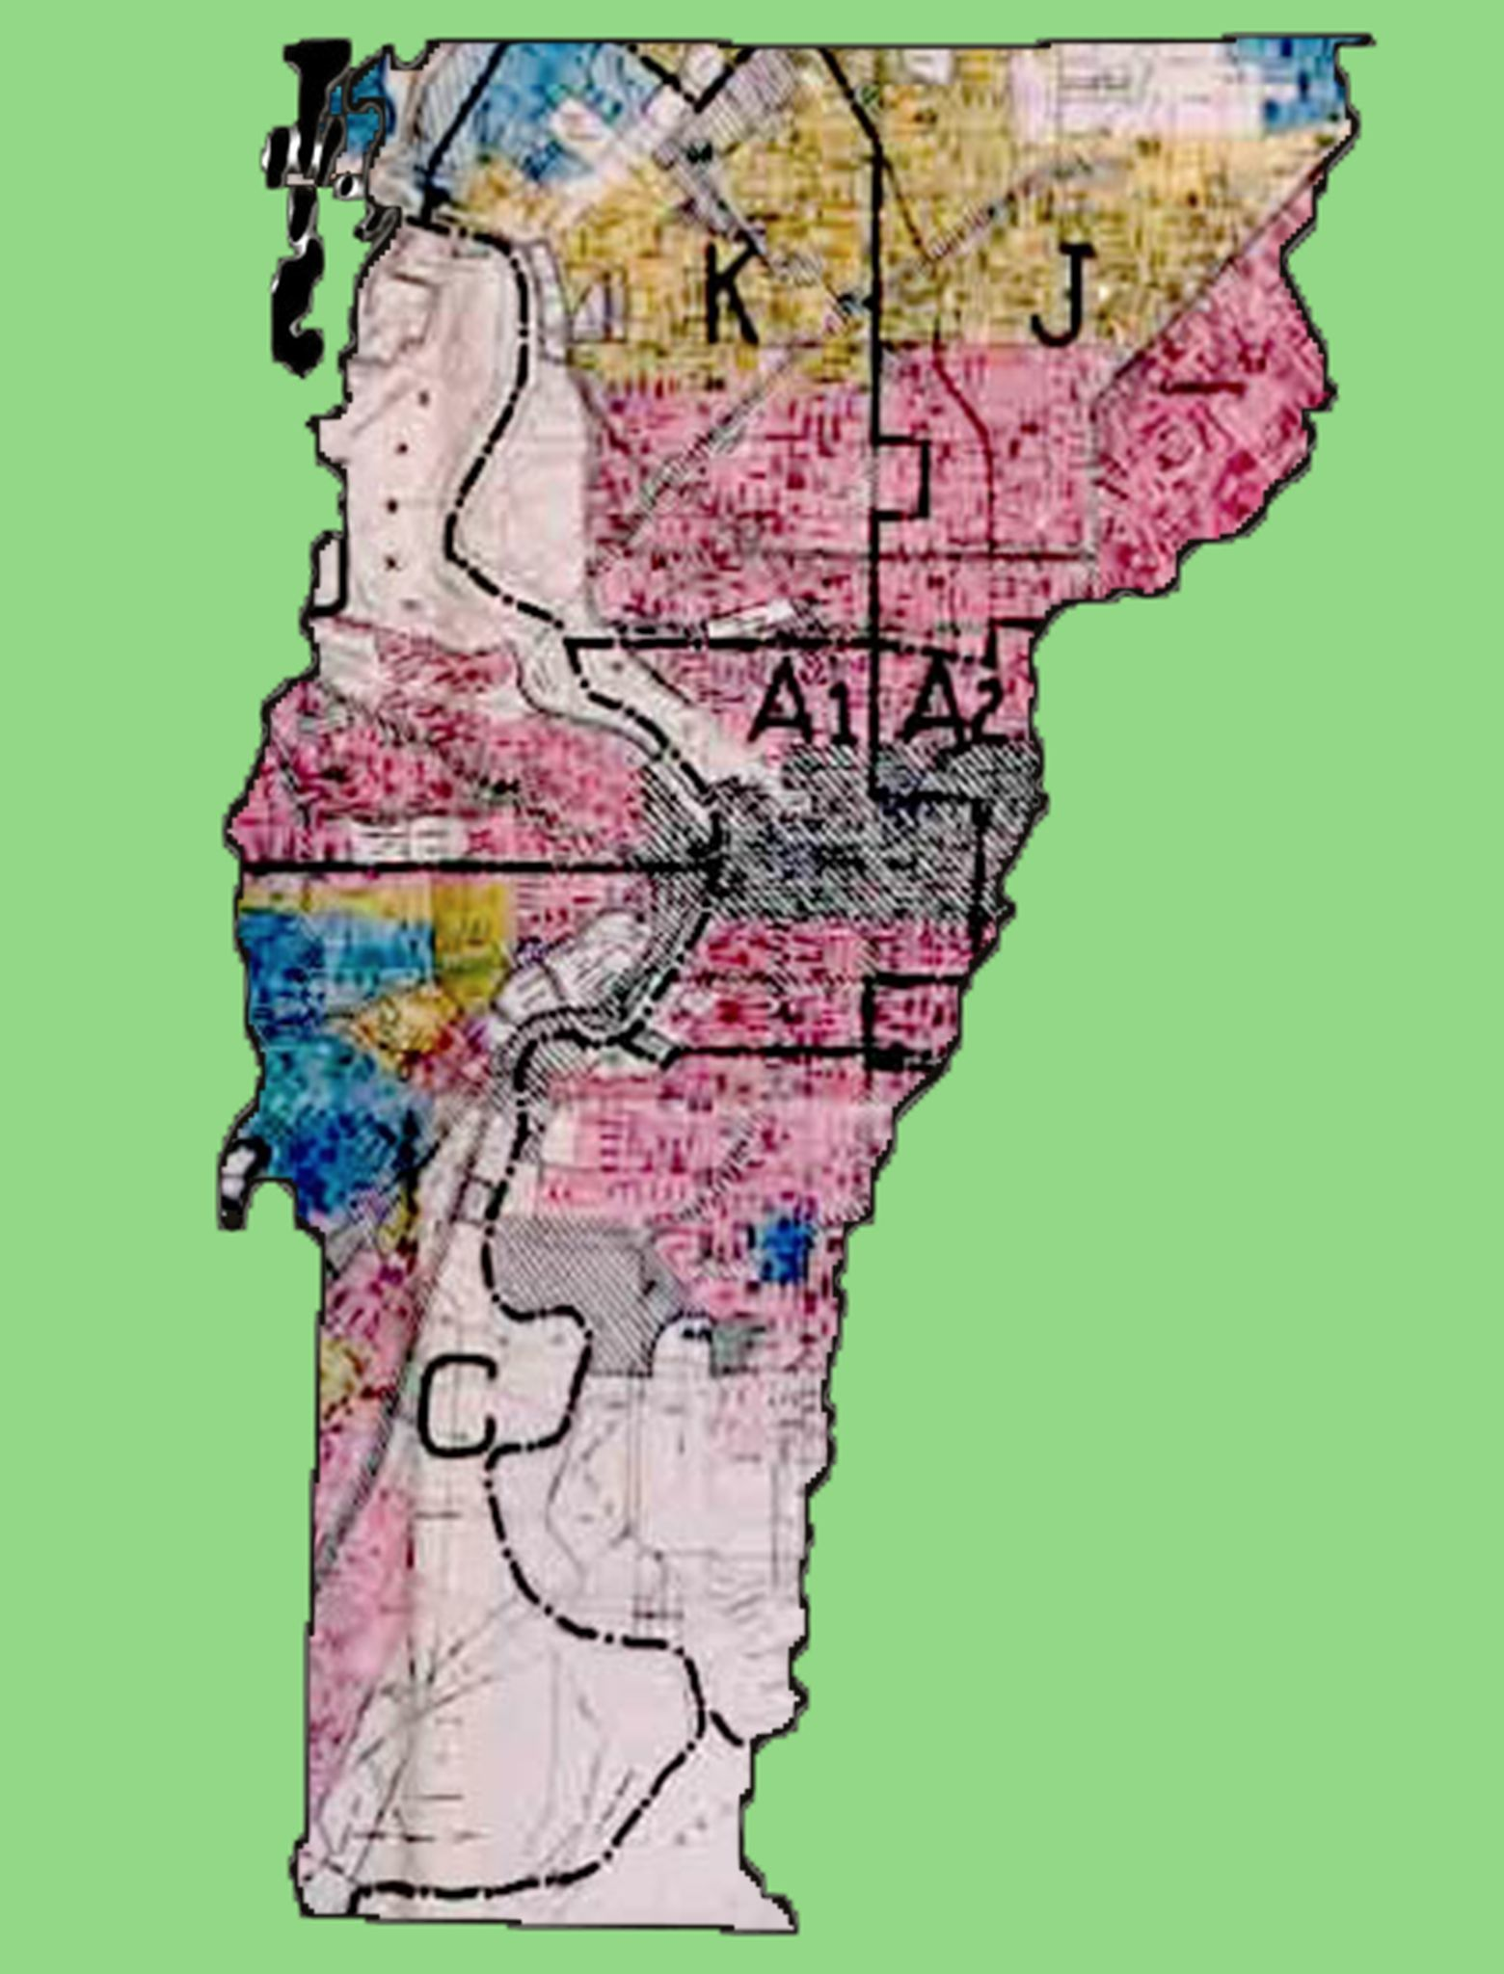
The Time is Now to Take Action!
Our work currently is to collaborate 1:1 with Vermont High Schools to incorporate the Color of Law into every learner's high school experience.
These results propelled us to launch The Color of Law Project, which centers around promoting education on racial housing discrimination. We draw inspiration from the Color of Law book, by Richard Rothstein.
Redlining map printed on Vermont state map.
Credits to Beth White

Slide 5
Why We Need You To Act Now
These conversations are so vital to our time right now; dismantling white supremacy and racism starts with acknowledging the unfair structures that were put in place generations ago and continue today. If we want to change society, we need to start with learning about these deep-rooted issues.

Slide 6
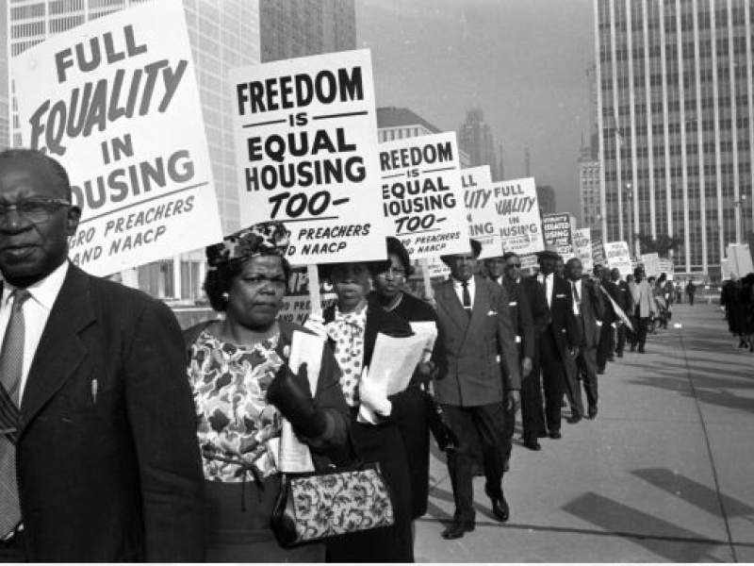
Book excerpts
“By failing to recognize that we now live with the severe, enduring effects of segregation, we avoid confronting our constitutional obligation to reverse it”
The Color of Law, page 11
“About one-third of middle- and upper- income black families now live in neighborhoods bordering severely disadvantaged areas, while only 6 percent of income-similar white families do so. [Y]outh growing up in predominantly African American communities, even middle class ones, will gain no experience mastering a predominantly white professional culture in which they, as adults, will want to succeed.”
The Color of Law, page 203

Slide 7
Student Testimony on the Color of Law lesson
“Let's talk more about this! How about in South Burlington??!! This is happening now.”
--South Burlington High School Senior
Check out a VPR interview with Minelle Sarfo-Adu, a student from our Color of Law project team!
“This lesson has definitely made me more aware of all the racism and inequality. I never knew the wealth gap was that bad and that housing was one of the main causes.”
--South Burlington High School Senior

Slide 8
Here’s how YOU can get involved!
Notes:
https://docs.google.com/forms/d/e/1FAIpQLSftmsnmxahVk6TGk3AAQ13Rc549tpzYM7mDaaaAU_OAYPvzmQ/viewform?usp=sf_link

Slide 9
Step One:
Join a growing number of VT teachers bringing the Color of Law lessons to our classrooms!

Slide 10
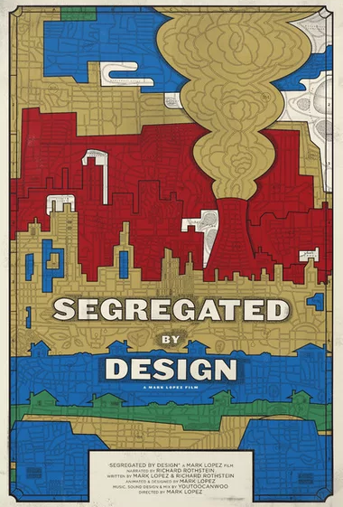
Resources: Book and Video
Click the book for a link to fill out a survey for FREE COPIES FOR YOUR CLASS!
Click the image for a link to a short video summation on the book

Slide 11
Resources: Lesson Plans
Using the book OR video, these lessons can be taught in less than three 90-minute class periods!
For a full, premade, VT-tested example teaching plan press this Link
Additional resources:
Learning for Justice
The Zinn Ed project

Slide 12
Step Two:
After teaching this lesson, please fill out our survey!
(This data will help us in future presentations as we push to include this lesson in statewide curriculum)

Slide 13
Repeat next semester!
We encourage you to make this a repeated lesson so all students have the ability to become more inclusive and learn more about the untold truths in our government

Slide 14
Thank you!
To all educators and community members for listening and being open minded. You’re a huge part of the change!

